Slide 1
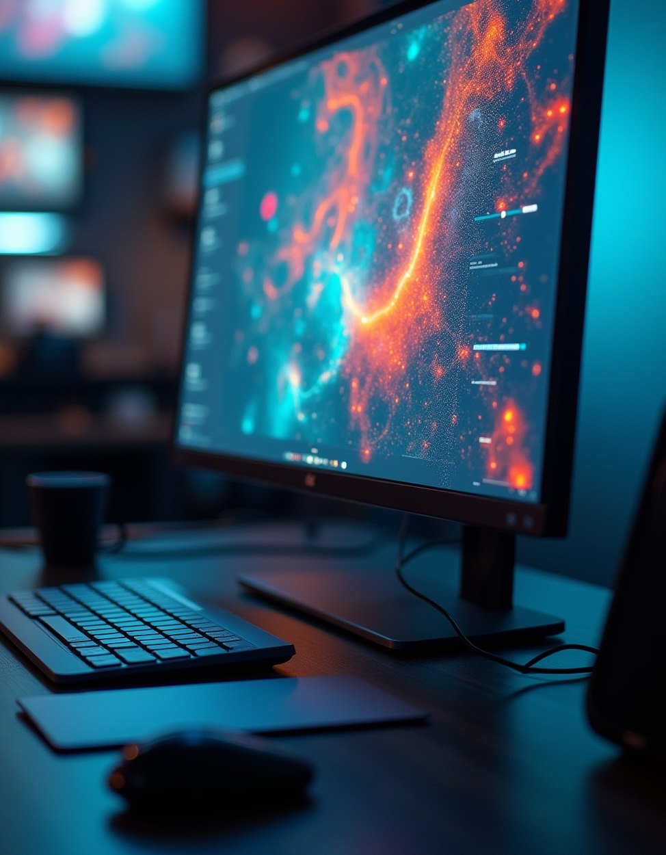
AI Vision Extract
Presented By: Deepanshu

Slide 2

Introduction
AI Vision Extract is a deep learning application that automates image segmentation and object extraction with high accuracy. Powered by a DeepLabV3-ResNet50 model trained on the COCO dataset, it allows seamless object isolation from complex backgrounds through a user-friendly Streamlit web interface.

Slide 3
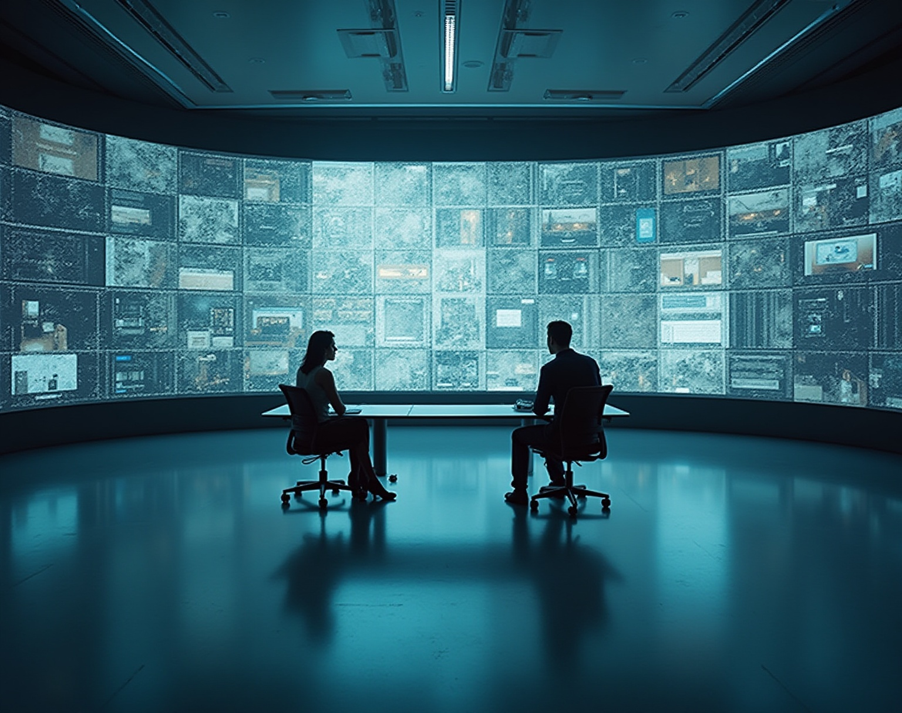
01
AI Vision Extract Overview

Slide 4

Introduction and Scope
AI Vision Extract automates object segmentation for diverse fields including e-commerce, medical imaging, autonomous vehicles, and augmented reality. It supports JPG/PNG image processing, identifying and isolating key objects efficiently with black-background isolation for clear outputs suited to research, development, and industrial needs.

Slide 5
Importance and
Applications
The system drastically reduces manual labeling effort while improving speed and accuracy. It enhances AI workflows by generating clean labeled data, benefiting education and industry alike. Key applications span product background removal, medical anomaly detection, real-time vehicle object tracking, and augmented reality scene editing.

Slide 6
Existing vs Proposed
System
Traditional segmentation methods rely on manual pixel selection or static thresholding, often resulting in inconsistent and imprecise results. Existing AI tools commonly face slow processing speeds and noisy mask outputs, coupled with limited interactive interfaces. The proposed system integrates an optimized DeepLabV3-ResNet50 model with feature enhancement layers and CUDA acceleration, providing faster, more accurate segmentation and a streamlined Streamlit interface for ease of use.

Slide 7
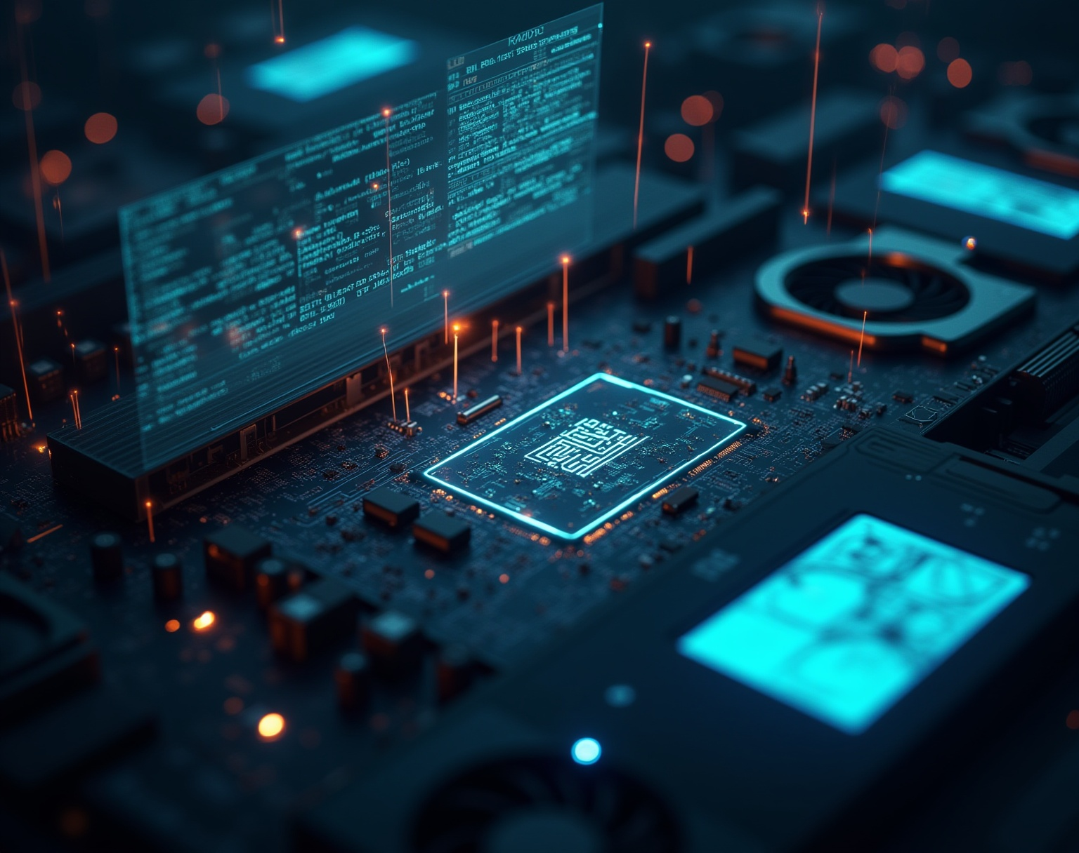
02
Technical Details

Slide 8
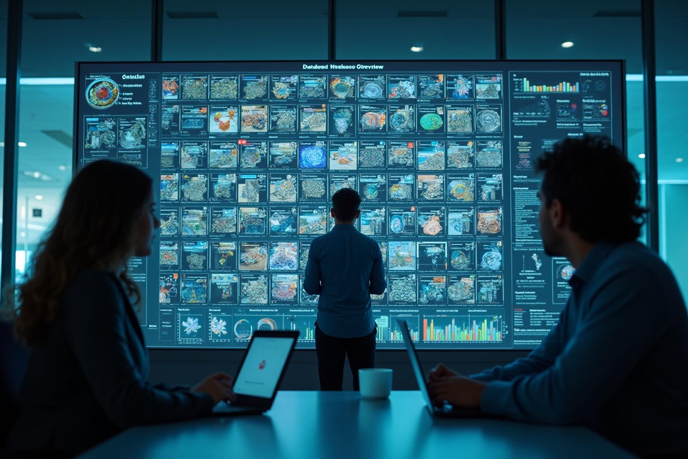
Dataset and Metrics
The system is trained and evaluated on the COCO dataset, which includes over 200,000 labeled images with more than 80 object categories. This diverse dataset enables strong generalization to varied real-world scenarios. Key performance metrics include 92% pixel accuracy, a mean Intersection over Union (IoU) of 85%, and inference speed of 0.8 seconds per image on GPU.

Slide 9
Architecture and
Pipeline
The architecture features a DeepLabV3-ResNet50 backbone enhanced with additional convolutional and batch normalization layers for refined feature extraction. The pipeline involves image upload via Streamlit, preprocessing, model inference to predict segmentation masks, post-processing for mask refinement, and output generation for user download, leveraging automated Google Drive integration for model weight management.

Slide 10
System Performance and User
Interface
The system benefits from CUDA GPU acceleration for rapid inference and post-processing techniques that produce smooth, precise masks. The Streamlit front end offers an intuitive interface allowing real-time image upload, segmentation visualization, and easy download of results, facilitating seamless user interaction and efficient workflow integration across various applications.

Slide 11
Conclusions
AI Vision Extract successfully combines advanced deep learning algorithms with accessible web technology to deliver a precise, fast, and user-friendly object segmentation tool. Its scalability and versatility ensure significant value across academic research, industrial applications, and commercial use cases, promoting efficiency and innovation in automated image processing workflows.

Slide 12
THANK YOU

